Slide 1
Linguistic macro-areas in Africa: when “boundaries” are areas themselves
Tom Güldemann
Humboldt University Berlin
Max Planck Institute for the Science of Human History Jena

Slide 2
1 Introduction
Table 1: Scalar levels in the analysis of linguistic contact (Muysken 2007, 2008: 5)
Level | Space | Time | Sources | Disciplines | Scenarios
Person | Bilingual individual | 0-50 years | Recordings, tests, and experiments | Psycho-linguistics | Brain connectivity
Micro | Bilingual community | 20-200 years | Recordings and fieldwork observations | Socio- and anthropological linguistics | Specific contact scenarios
Meso | Geographical region | Generally 200-1000 years | Comparative data; historical sources | Historical linguistics | Global contact scenarios
Macro | Larger areas of the world | Deep time | Typological, genetic, archeo-logical data | Areal typology | Vague or no contact scenarios

Slide 3
2 Macro-areas in Africa
2.1 Recent state of the art
first more comprehensive research by Greenberg (1959, 1983) and Heine (1975, 1976)
resumed independently by Güldemann (e.g., 1998, 1999, 2001, 2003, 2005, 2008, 2010) and Clements and Rialland (2008)
> considerably similar results of proposed macro-areal feature aggregations before recent large-scale colonizations

Slide 4
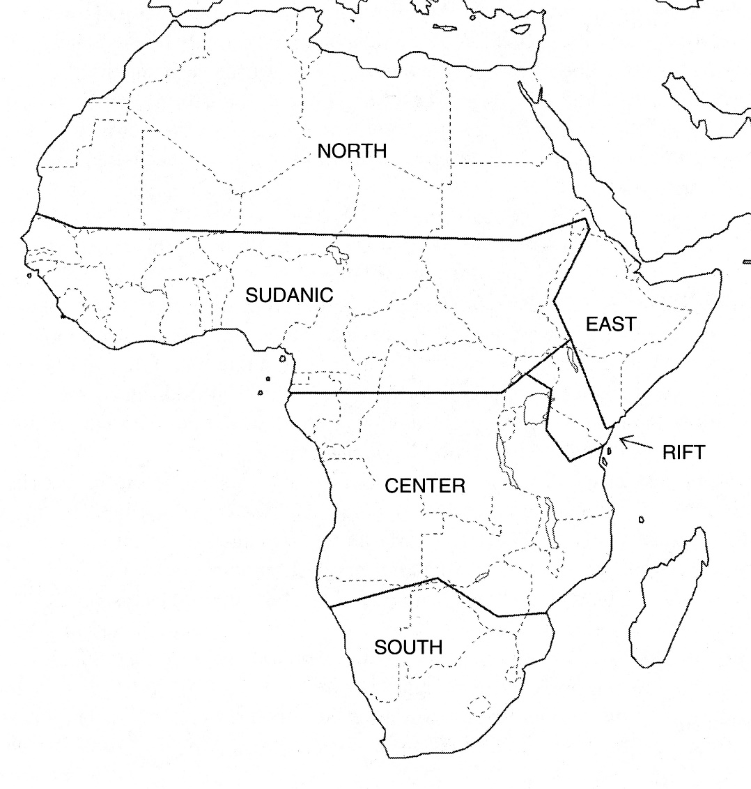
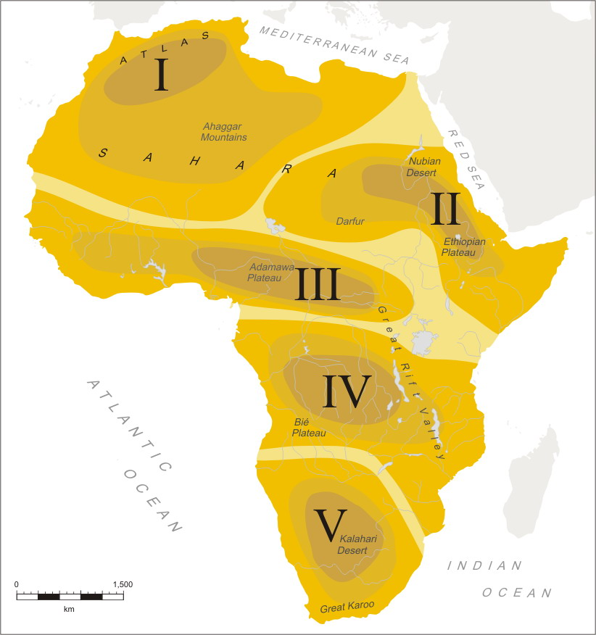
2.1 Recent state of the art
Notes: I Sahara spread zone, II Chad-Ethiopia, III Macro- Sudan belt, IV Bantu spread zone, V Kalahari Basin
Clements and Rialland (2008) Güldemann (2010)

Slide 5
2.2 Characteristics of macro-areas
special conceptualization of the concept of macro-area and its wider territorial environment (Güldemann 2010: 576):
a) no necessary reconstruction of contact history (see Muysken 2007)
> scenarios crucially include both “horizontal” borrowing through space and “vertical” shift-induced substrate interference through time
b) no either-or membership of languages/lineages, rather gradient of affiliation
c) distinction of core vs. periphery: represented by purely symbolic rather than substantive area-internal differentiation by shade
> no geographically describable, exact area “boundaries”, hence represented in indeterminate fashion as quasi-featureless zones

Slide 6
2.1 Recent state of the art
Notes: I Sahara spread zone, II Chad-Ethiopia, III Macro- Sudan belt, IV Bantu spread zone, V Kalahari Basin
Clements and Rialland (2008) Güldemann (2010)

Slide 7
2.3 An update
2.3.1 Genealogical linguistics
historical interpretation of large-scale areal linguistic patterns is contingent on the genealogical language classification in the given geographical space
Greenberg’s (1963) classification with 4 African “families” widely accepted but not robust (e.g., Campbell and Poser 2008)
review of state of language classification by Güldemann (forthcoming b), oriented to standard criteria (e.g., Nichols 1996, Campbell 2003)
> genealogically far more diverse picture (see Map 3, Table A1):
- 2 large families: Niger-Congo, Afroasiatic
- 3 intermediate families: Central Sudanic, Nilotic-Surmic, Mande
- 35+ units (>12 singletons) without convincing affiliation

Slide 8
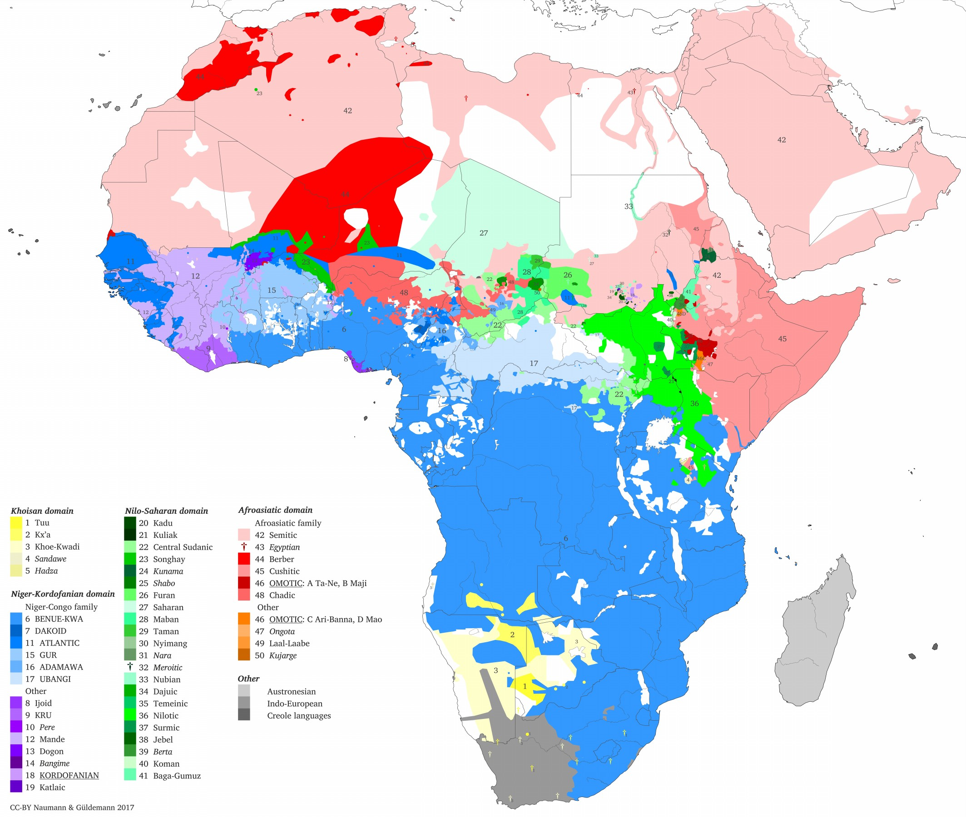
2.3 An update
2.3.1 Genealogical
linguistics
Güldemann
(forth. b)

Slide 9
2.3 An update
2.3.1 A new macro-areal profile for Afrabia
external separation and internal partition:
new: continent-sized unit “Afrabia” = Africa + Arabian Peninsula
- behaves internally as a unit
- bounded by Southwest Asian transition zone (cf. Haig 2017, Haig and Khan forth.)
old: two spread zones II, VI vs.
three contact-related macro-areas I, III, V (see Tables A2-4)
new: transition sphere IV with two subareas (separate III from V/VI

Slide 10
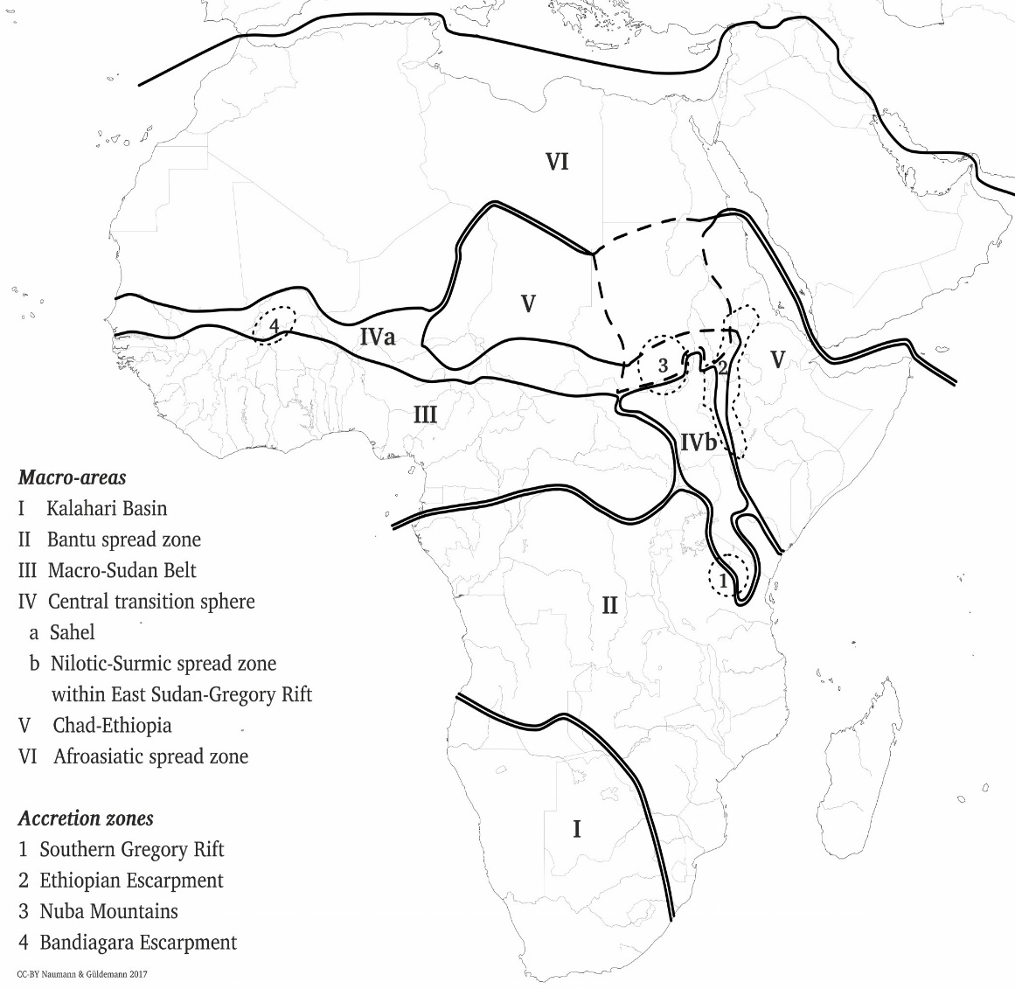
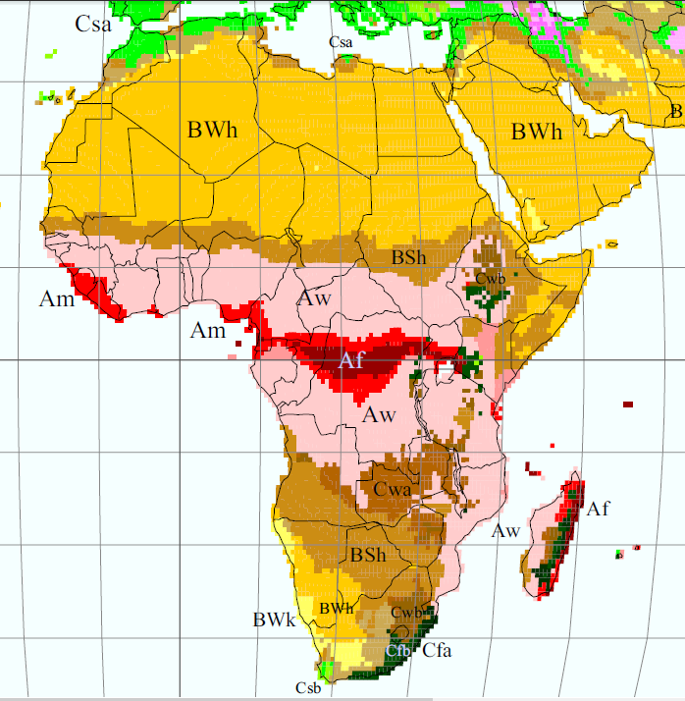
2.3 An update
2.3.1 A new macro-areal profile for Afrabia
Güldemann (forthcoming a) Kottek et al. (2006)

Slide 11
2.3 An update
2.3.1 A new macro-areal profile for Afrabia
considerable overlap with geographical-climatic macro-conditions (Kottek et al. 2006):
B = Arid south: I Kalahari Basin
A = Equatorial: II Bantu spread zone, III Macro-Sudan belt, IVb East Sudan-Gregory Rift
B = Arid north: IVa Sahel, V Chad-Ethiopia, VI Afroasiatic spread zone
major caveats:
- feature distributions to be tested for statistical significance
- macro-areas only temporal and partly asynchronic snapshots

Slide 12
2.3 An update
2.3.1 A new macro-areal profile for Afrabia
Güldemann (forthcoming a) Kottek et al. (2006)

Slide 13
3 Macro-areal “boundaries” in Africa
Güldemann (forth. b) only apparently reverts back to line-like boundaries
> goal here: determine diverse character of “boundaries” by four test cases that are geographical spaces with their own linguistic dynamics
to be characterized as follows:
a) macro-areal location
b) geography
c) linguistic ecology
d) linguistic structural profile
e) population and language dynamics
f) “boundary” character

Slide 14
3.1 The Red Sea-Gulf of Aden as a plain boundary

Slide 15
3.1 The Red Sea-Gulf of Aden as a plain boundary
a) gulf-type ocean water bodies between Horn of Africa and Arabian Peninsula with Bab al-Mandab Strait as one narrowing
> separates northeastern flank of V Chad-Ethiopia from VI Afroasiatic spread zone
b) traversable sea containing a few small islands
c) n.a., without major settlement except for one geographically peripheral island with separate South Arabian language Soqotri

Slide 16
3.1 The Red Sea-Gulf of Aden as a plain boundary
d) n.a. (Soqotri = canonical South Arabian)
e) South Semitic crossing from Arabia into Horn of Africa as major population event
shift of colonizing Semitic to local Ethiopian profile primarily due to substrate interference from (remotely related) Cushitic languages
> shift-induced emergence of Ethiosemitic
- hardly any affinities between macro-areas beyond genealogical isoglosses of Semitic-Cushitic (cf. Simeone-Senelle & V. 2006)
f) quite canonical “boundary” between two macro-areas in terms of both geography and linguistics

Slide 17
3.2 The Ethiopian escarpment as an accretion zone

Slide 18
3.2 The Ethiopian escarpment as an accretion zone
a) longitudinal transition zone between the Ethiopian Plateau and the western lowlands stretching from Eritrea in the north to the northern edge of Lake Turkana in the south
> separates one part of eastern flank of V Chad-Ethiopia from Nilotic- Surmic spread zone as part of IVb East Sudan-Gregory Rift
b) marked escarpment topography entailing altitude differences and including partly preserved lowland and montane rainforests
- also traced by national borders between Eritrea+Ethiopia and Sudan+South Sudan
- nevertheless, no real barrier for population movement

Slide 19
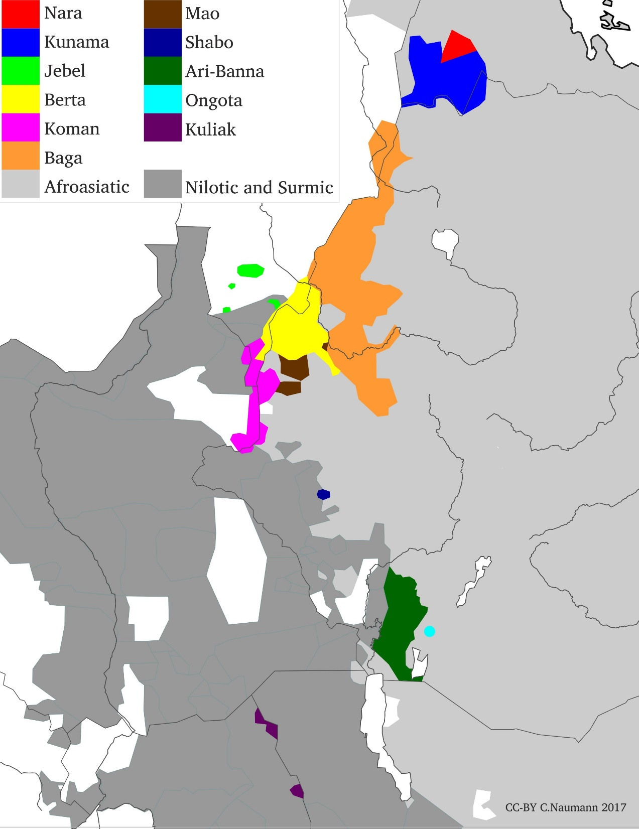
3.2 The Ethiopian escarpment
as an accretion zone
Note: white areas = water bodies,
uninhabited or other
languages not of concern

Slide 20
3.2 The Ethiopian escarpment as an accretion zone
c) exceptionally high ethno-linguistic diversity (cf. Bryan 1945):
- arguably exceeds that of the Nuba Mountains in the south of Sudan
- mostly endemic “remnant” lineages (Grottanelli 1948, 1966)
> linguistic accretion zone in terms of Nichols (1992, 1997)
Notes: Single language, * syntax unknown, Core with few external structural links
Table 2: Linguistic lineages of the Ethiopian Escarpment
Lineage type | Eastern “face” with head-final syntax | Western “face” with head-initial syntax | No.
Endemic isolate | Kunama, ? Nara, Mao, Shabo, Ari-Banna, Ongota | Jebel, Berta, Koman, Baga | 10/9
Endemic isolate in larger family | Ta-Ne + Maji (of Afroasiatic), Nara (?of Wadi Howar) | - | 2/3
Colonizing | Cushitic (notably Oromo) (of Afroasiatic) | Arabic (of Afroasiatic); Nilotic-Surmic | 3
Unclassifiable | - | Gule | 7
 | Dima of Bottegò, Dume, Funj, Gomba, Mangio, Tamma*

Slide 21
3.2 The Ethiopian escarpment
as an accretion zone
Note: white areas = water bodies,
uninhabited or other
languages not of concern

Slide 22
3.2 The Ethiopian escarpment as an accretion zone
d) Bryan (1945): “linguistic no-man's land”, today poorly documented
- high structural diversity across various local lineages
- “janus-headed” orientation with eastern and western “face”:
e) intensive population and language contact and partly movement
> confusing ethnic categorizations (cf., e.g., James 1981, Küspert 2015)
- Encroachment both “downhill” and “uphill”
> no obvious trend of dissolving the wider linguistic east-west divide
f) relatively well defined geographical profile due to topography
- core marginalized “spillover” of eastern and western neighborhood
> robust “boundary” between two macro-areas - shapes Chad-Ethiopia

Slide 23
3.3 The Sahel as a transition area

Slide 24
3.3 The Sahel as a transition area
a) wide territorial band spanning from the Atlantic eastward, geographically up to Ethiopian Escarpment but linguistically with fuzzy picture east of Lake Chad > focus on western part
> separates northern flank of III Macro-Sudan belt from VI Afroasiatic spread zone
b) marked by climatic conditions (cf. BSh in Kottek et al. 2006)
- no shape-tracing or interruptive topographic landmark(s) but locally important physical features - from east to west: Bandiagara Escarpment, Niger River bend, Lake Chad Basin
- no barrier for crossing and other movement, but like a movement- conducive corridor (Fula!)

Slide 25
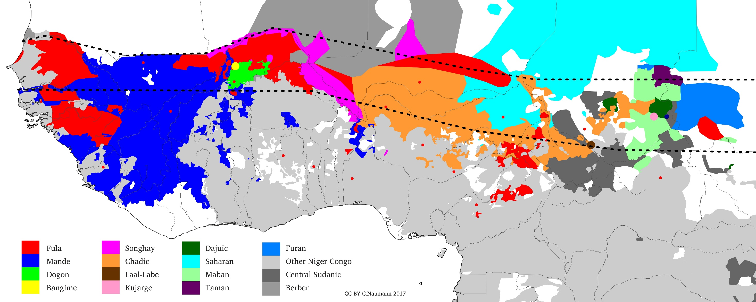
3.3 The Sahel as a transition area
Note: white areas = water bodies, uninhabited or other languages not of concern

Slide 26
3.3 The Sahel as a transition area
c) linguistically diverse but over a large territory
- diversity level intermediate between neighboring macro-areas
- vehiculars: Fula, Manding, Zarma, Hausa, Kanuri
- several lineages with presence in neighboring macro-areas
from Lake Chad eastward lineages of Chad-Ethiopia and Macro-Sudan
Notes: Single language, Lineage with diversity according to macro-area
Table 3: Linguistic lineages of the Sahel (Güldemann forthcoming b)
Lineage type | Head-final syntax | Head-initial syntax | No.
Endemic isolate | Dogon | Bangime, Laal-Labe, Kujarge, Dajuic | 5
Also in VI | - | Songhay | -
Also in III | (Mande) | Fula of Niger-Congo, Songhay, Chadic | 4
Aligned in East with other area | V: Saharan, Maban, Taman, Furan | III: Central Sudanic, other Niger-Congo | 4
Unclassifiable | Mige, Mimi of Decorse, Mimi of Nachtigal |  | 3

Slide 27
3.3 The Sahel as a transition area
Note: white areas = water bodies, uninhabited or other languages not of concern

Slide 28
3.3 The Sahel as a transition area
d) no area-wide features and moderate structural diversity
- multiple macro-areal presence of lineages correlates with profile
e) considerable dynamics, notably by “active” languages
- latitudinal expansions and interaction: Fula, Manding, Songhay, Hausa
> large empires partly replacing each-other - chain of contact settings
longitudinal immigration from north vs. emigration southward
- topographic landmarks as internal contact foci: Lake Chad Basin
f) differs from neighborhood by linguistic ecology and lack of unity
- climatically induced by latitude gradience (Güldemann and Ha. forth.)
> permeable/dissolvable transition zone between other latitude areas

Slide 29
3.4 The southern Bantu fringe as a moving linguistic frontier

Slide 30
3.4 The southern Bantu fringe as a moving linguistic frontier
a) traces the south(west)ern border regions of Angola, Zambia, Zimbabwe and then south through eastern part of South Africa
> “separates” I Kalahari Basin from II Bantu spread zone
!!! synchronically no discernible line-like boundary, instead a patchwork where Bantu (and Afrikaans in the southwest) increasingly engulfs “Khoisan” whose rough extension is merely reconstructed by the idealized boundary in Map 2
b) no salient topographical and environmental barriers
- localized climatically induced differences: various hyper-arid zones in the interior and along west coast, differential rainfall regimes in the South African Cape region (subsistence barrier for Bantu)

Slide 31
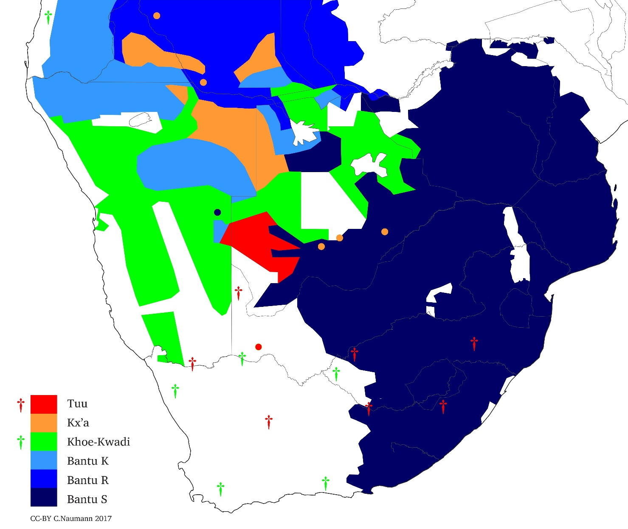
3.4 The southern Bantu fringe as a moving linguistic frontier
Note: white areas = water bodies, uninhabited or other languages not of concern

Slide 32
3.4 The southern Bantu fringe as a moving linguistic frontier
c) moderate ethnolinguistic diversity
some languages widespread but with low population density
Table 4: Linguistic lineages of the Bantu-“Khoisan” frontier (Güldemann forth. b)
d) no unifying structural profile (substrate features in colonizing lineages only sporadic, see Güldemann and Fehn 2017)
Lineage type | List | No.
Endemic isolate | Tuu, Kx’a | 2
Presumably colonizing | Khoe-Kwadi | 1
Colonizing | Bantu of Niger-Congo (of different zones K, R, S); Afrikaans | 2

Slide 33
3.4 The southern Bantu fringe as a moving linguistic frontier
Note: white areas = water bodies, uninhabited or other languages not of concern

Slide 34
3.4 The southern Bantu fringe as a moving linguistic frontier
e) Bantu replacing “Khoisan”, as Khoe with Tuu and Kx’a before
- Bantu fragmentation: selective migration, territorial leapfrogging
- latest phase of general process submerging other larger macro-areas:
- possibly “Southern High Africa” = southern + East Africa (cf. Güldemann 2010)
- “Southern Africa” = Kalahari Basin + Southeastern Bantu) (cf. Clements & Rialland 2008, Naumann 2016)
f) hardly any “boundary” character (contra “front(ier)” terminology)
> geographically unstructured, moving frontier of a spread zone that replaces a macro-area (itself possibly spread zone before)

Slide 35
4 Macro-areal “boundaries”: a summary
“Boundaries” of macro-areas:
hardly ever “separate” in the literal sense but rather are permeable/ traversable to different degrees
are typically not static but rather (highly) dynamic
are recurrently not just by-products of neighboring macro-areas but actively interact with them, partly propelled by own internal forces
are typically not “line-like” but rather represent areas themselves that seem to differ from other macro-areas first of all by the lack of internally defining linguistic signatures

Slide 36
4 Macro-areal “boundaries”: a summary
all above characteristics arguably determined first of all by variably marked geographical differentials with respect to both their adjacent macro-area and between each other - this in a scalar fashion:
I irregular topographical barriers of varying degrees of permeability:
- substantial water body 3.1 Red Sea-Gulf of Aden
- altitude distinction 3.2 Ethiopian Escarpment
II regular (latitudinal) climate pattern with typically gradual transition:
3.3 Sahel
3.4 Bantu-“Khoisan” frontier
III neither I nor II neither area nor boundary

Slide 37
Are there similarities , if metaphorically, to boundaries in contexts of smaller scales?

